Slide 1
Association Rule Mining

Slide 2
Contents
Market Basket Analysis
Association Rule Mining
Apriori Algorithm
FP- Growth Algorithm

Slide 3
Association
Association rule learning is a popular and well researched method for discovering interesting relations between variables in large databases.
Association is a data mining function that discovers the probability of the co-occurrence of items in a collection. The relationships between co-occurring items are expressed as association rules.
Association rules are often used to analyze sales transactions. For example, it might be noted that customers who buy cereal at the grocery store often buy milk at the same time. In fact, association analysis might find that 85% of the checkout sessions that include cereal also include milk. This relationship could be formulated as the following rule.
Cereal implies milk with 85% confidence

Slide 4


Market Basket Analysis
Market Basket Analysis is one of the key techniques used by large retailers to uncover associations between items. They try to find out associations between different items and products that can be sold together, which gives assisting in right product placement. Typically, it figure out what products are being bought together and organizations can place products in a similar manner. Let’s understand this better with an example:

Slide 5
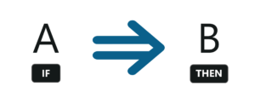
Association Rule Mining
Association rules can be thought of as an IF-THEN relationship. Suppose item A is being bought by the customer, then the chances of item B being picked by the customer too under the same Transaction ID is found out.
There are two elements of these rules:
Antecedent (IF): This is an item/group of items that are typically found in the Itemsets or Datasets.
Consequent (THEN): This comes along as an item with an Antecedent/group of Antecedents.

Slide 6
Measures
There are 3 ways to measure association:
Support
Confidence
Lift

Slide 7
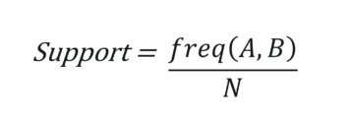
Support
Support: It gives the fraction of transactions which contains item A and B. Basically Support tells us about the frequently bought items or the combination of items bought frequently.
So with this, we can filter out the items that have a low frequency.

Slide 8
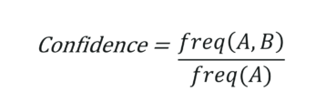
Confidence
Confidence: It tells us how often the items A and B occur together, given the number times A occurs.
Typically, when you work with the Apriori Algorithm, you define these terms accordingly.

Slide 9
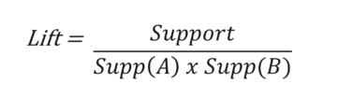
Lift
Lift: Lift indicates the strength of a rule over the random occurrence of A and B. It basically tells us the strength of any rule.
Focus on the denominator, it is the probability of the individual support values of A and B and not together. Lift explains the strength of a rule. More the Lift more is the strength. Let’s say for A -> B, the lift value is 4. It means that if you buy A the chances of buying B is 4 times.

Slide 10

Apriori Algorithm
Apriori algorithm uses frequent itemsets to generate association rules. It is based on the concept that a subset of a frequent itemset must also be a frequent itemset. Frequent Itemset is an itemset whose support value is greater than a threshold value(support).

Slide 11
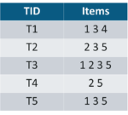
Let’s say we have the following data of a store.

Slide 12
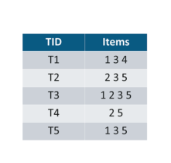
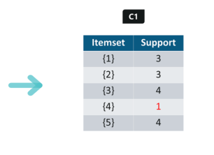
Iteration 1: Let’s assume the support value is 2 and create the item sets of the size of 1 and calculate their support values.

Slide 13
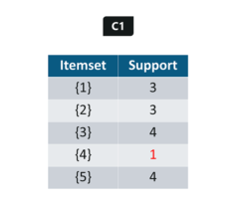
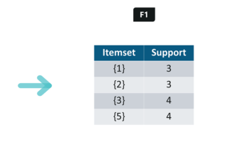
As you can see here, item 4 has a support value of 1 which is less than the min support value. So we are going to discard {4} in the upcoming iterations. We have the final Table F1.

Slide 14
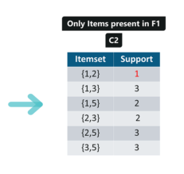
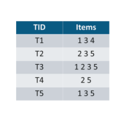
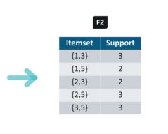
Iteration 2: Next we will create itemsets of size 2 and calculate their support values. All the combinations of items set in F1 are used in this iteration.
Itemsets having Support less than 2 are eliminated again. In this case {1,2}. Now, Let’s understand what is pruning and how it makes Apriori one of the best algorithm for finding frequent itemsets.

Slide 15
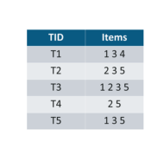
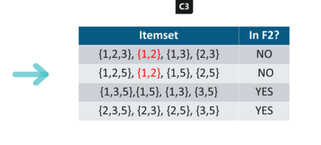
Pruning: We are going to divide the itemsets in C3 into subsets and eliminate the subsets that are having a support value less than 2.

Slide 16
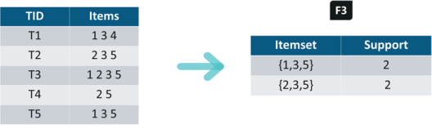
Iteration 3: We will discard {1,2,3} and {1,2,5} as they both contain {1,2}. This is the main highlight of the Apriori Algorithm.

Slide 17
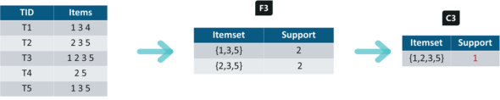
Iteration 4: Using sets of F3 we will create C4.
Since the Support of this itemset is less than 2, we will stop here and the final itemset we will have is F3. Note: Till now we haven’t calculated the confidence values yet.

Slide 18
With F3 we get the following itemsets:
For I = {1,3,5}, subsets are {1,3}, {1,5}, {3,5}, {1}, {3}, {5} For I = {2,3,5}, subsets are {2,3}, {2,5}, {3,5}, {2}, {3}, {5}
Applying Rules: We will create rules and apply them on itemset F3. Now let’s assume a minimum confidence value is 60%.
For every subsets S of I, you output the rule
S -> (I-S) (means S recommends I-S)
if support(I) / support(S) >= min_conf value

Slide 19
{1,3,5}
Rule 1: {1,3} -> ({1,3,5} — {1,3}) means 1 & 3 -> 5
Confidence = support(1,3,5)/support(1,3) = 2/3 = 66.66% > 60%
Hence Rule 1 is Selected
Rule 2: {1,5} -> ({1,3,5} — {1,5}) means 1 & 5 -> 3
Confidence = support(1,3,5)/support(1,5) = 2/2 = 100% > 60%
Rule 2 is Selected
Rule 3: {3,5} -> ({1,3,5} — {3,5}) means 3 & 5 -> 1
Confidence = support(1,3,5)/support(3,5) = 2/3 = 66.66% > 60%
Rule 3 is Selected

Slide 20
Rule 4: {1} -> ({1,3,5} — {1}) means 1 -> 3 & 5
Confidence = support(1,3,5)/support(1) = 2/3 = 66.66% > 60%
Rule 4 is Selected
Rule 5: {3} -> ({1,3,5} — {3}) means 3 -> 1 & 5
Confidence = support(1,3,5)/support(3) = 2/4 = 50% <60%
Rule 5 is Rejected
Rule 6: {5} -> ({1,3,5} — {5}) means 5 -> 1 & 3
Confidence = support(1,3,5)/support(5) = 2/4 = 50% < 60%
Rule 6 is Rejected

Slide 21
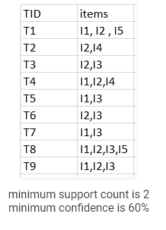
One more example

Slide 22
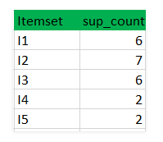
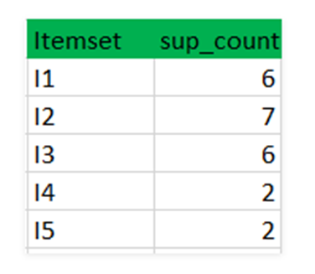
Step-1: K=1
(I) Create a table containing support count of each item present in dataset – Called C1(candidate set)
compare candidate set item’s support count with minimum support count(here min_support=2 if support_count of candidate set items is less than min_support then remove those items). This gives us itemset L1.

Slide 23
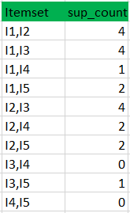
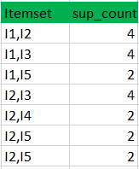
Step-2: K=2
Generate candidate set C2 using L1 (this is called join step). Condition of joining Lk-1 and Lk-1 is that it should have (K-2) elements in common.
Check all subsets of an itemset are frequent or not and if not frequent remove that itemset.(Example subset of{I1, I2} are {I1}, {I2} they are frequent.Check for each itemset)
Now find support count of these itemsets by searching in dataset.
Filter min support count

Slide 24

Step-3:
Generate candidate set C3 using L2 (join step). Condition of joining Lk-1 and Lk-1 is that it should have (K-2) elements in common. So here, for L2, first element should match.
So itemset generated by joining L2 is {I1, I2, I3}{I1, I2, I5}{I1, I3, i5}{I2, I3, I4}{I2, I4, I5}{I2, I3, I5}
Check if all subsets of these itemsets are frequent or not and if not, then remove that itemset.(Here subset of {I1, I2, I3} are {I1, I2},{I2, I3},{I1, I3} which are frequent. For {I2, I3, I4}, subset {I3, I4} is not frequent so remove it. Similarly check for every itemset)
find support count of these remaining itemset by searching in dataset.

Slide 25
Step-4:
Generate candidate set C4 using L3 (join step). Condition of joining Lk-1 and Lk-1 (K=4) is that, they should have (K-2) elements in common. So here, for L3, first 2 elements (items) should match.
Check all subsets of these itemsets are frequent or not (Here itemset formed by joining L3 is {I1, I2, I3, I5} so its subset contains {I1, I3, I5}, which is not frequent). So no itemset in C4
We stop here because no frequent itemsets are found further

Slide 26
Rules
Confidence –
A confidence of 60% means that 60% of the customers, who purchased milk and bread also bought butter.
Confidence(A->B)=Support_count(A∪B)/Support_count(A)
So here, by taking an example of any frequent itemset, we will show the rule generation.
Itemset {I1, I2, I3} //from L3
SO rules can be
[I1^I2]=>[I3] //confidence = sup(I1^I2^I3)/sup(I1^I2) = 2/4*100=50%
[I1^I3]=>[I2] //confidence = sup(I1^I2^I3)/sup(I1^I3) = 2/4*100=50%
[I2^I3]=>[I1] //confidence = sup(I1^I2^I3)/sup(I2^I3) = 2/4*100=50%
[I1]=>[I2^I3] //confidence = sup(I1^I2^I3)/sup(I1) = 2/6*100=33%
[I2]=>[I1^I3] //confidence = sup(I1^I2^I3)/sup(I2) = 2/7*100=28%
[I3]=>[I1^I2] //confidence = sup(I1^I2^I3)/sup(I3) = 2/6*100=33%
So if minimum confidence is 50%, then first 3 rules can be considered as strong association rules.

Slide 27
FP-growth
The two primary drawbacks of the Apriori Algorithm are:-
At each step, candidate sets have to be built.
To build the candidate sets, the algorithm has to repeatedly scan the database.
FP-Growth (frequent-pattern growth) algorithm is an improved algorithm of the Apriori algorithm put forward by Jiawei Han and so forth. It compresses data sets to a FP-tree, scans the database twice, does not produce the candidate item sets in mining process, and greatly improves the mining efficiency.

Slide 28
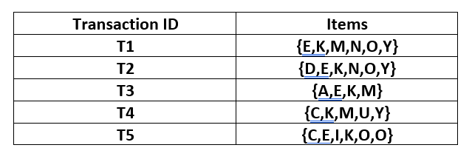
FP-Growth
Find all frequent item sets or frequent patterns in the following database using FP-growth algorithm. Take minimum support as 3 and minimum confidence as 60%.

Slide 29
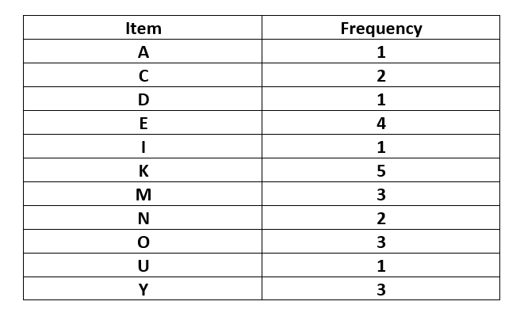
The above-given data is a hypothetical dataset of transactions with each letter representing an item. The frequency of each individual item is computed:-

Slide 30
The minimum support be 3. A Frequent Pattern set is built which will contain all the elements whose frequency is greater than or equal to the minimum support. These elements are stored in descending order of their respective frequencies. After insertion of the relevant items, the set L looks like this:-
L = {K : 5, E : 4, M : 3, O : 3, Y : 3}
Arrange in the decreasing order of support.

Slide 31
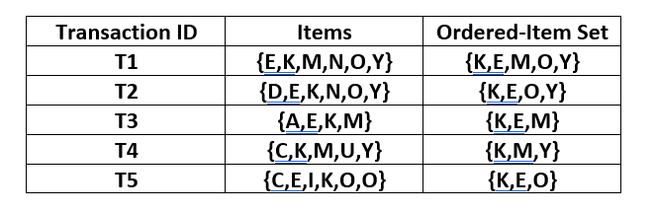
Now, for each transaction, the respective Ordered-Item set is built. It is done by iterating the Frequent Pattern set and checking if the current item is contained in the transaction in question. If the current item is contained, the item is inserted in the Ordered-Item set for the current transaction. The following table is built for all the transactions:-

Slide 32
Now, all the Ordered-Item sets are inserted into a Trie Data Structure.
Inserting the set {K, E, M, O, Y}
Here, all the items are simply linked one after the other in the order of occurrence in the set and initialize the support count for each item as 1.
Null
K:1
E : 1
M : 1
O : 1
Y : 1

Slide 33
Inserting the set {K, E, O, Y}:
Till the insertion of the elements K and E, simply the support count is increased by 1. On inserting O we can see that there is no direct link between E and O, therefore a new node for the item O is initialized with the support count as 1 and item E is linked to this new node. On inserting Y, we first initialize a new node for the item Y with support count as 1 and link the new node of O with the new node of Y.
Null
K : 2
K : 1
E : 2
E : 1
M : 1
O : 1
O : 1
Y : 1
Y : 1

Slide 34
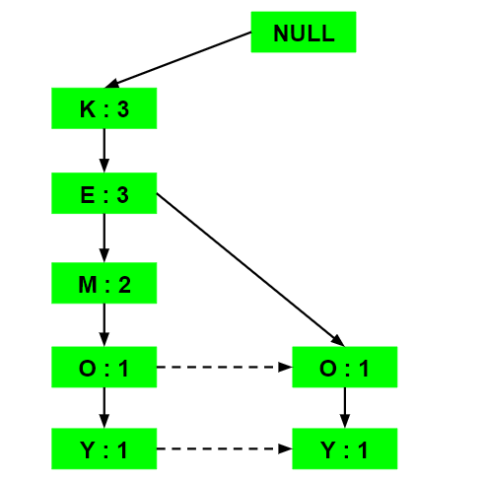
Inserting the set {K, E, M}:
Here simply the support count of each element is increased by 1.

Slide 35
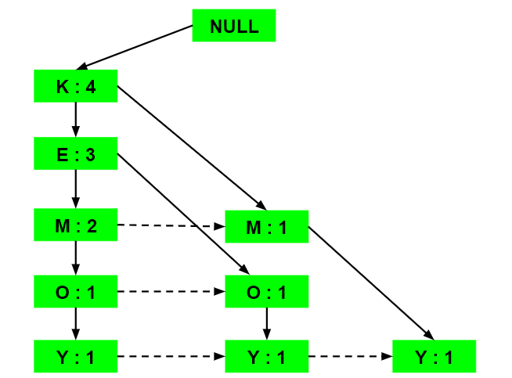
Inserting the set {K, M, Y}:
Similar to step b), first the support count of K is increased, then new nodes for M and Y are initialized and linked accordingly.

Slide 36
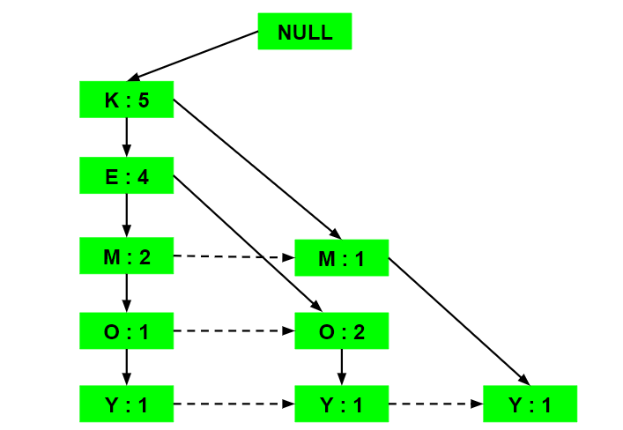
Inserting the set {K, E, O}:
Here simply the support counts of the respective elements are increased. Note that the support count of the new node of item O is increased.

Slide 37
Items | Conditional Pattern Base
Y | {K,E,M,O:1}, {K,E,O:1},{K,M:1}
O | {K,E,M:1}, {K,E:2}
M | {K,E:2}, {K:1}
E | {K:4}
K

Slide 38
Now for each item the Conditional Frequent Pattern Tree is built. It is done by taking the set of elements which is common in all the paths in the Conditional Pattern Base of that item and calculating it’s support count by summing the support counts of all the paths in the Conditional Pattern Base.
Items | Conditional Pattern Base | Conditional Frequent pattern tree
Y | {K,E,M,O:1}, {K,E,O:1},{K,M:1} | {K:3}
O | {K,E,M:1}, {K,E:2} | {K,E:3}
M | {K,E:2}, {K:1} | {K:3}
E | {K:4} | {K:4}
K

Slide 39
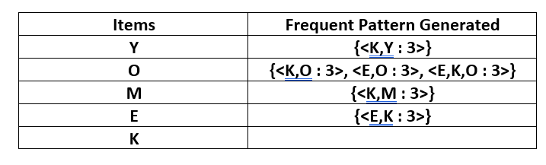
From the Conditional Frequent Pattern tree, the Frequent Pattern rules are generated by pairing the items of the Conditional Frequent Pattern Tree set to the corresponding to the item as given in the below table.
For each row, two types of association rules can be inferred for example for the first row which contains the element, the rules K -> Y and Y -> K can be inferred. To determine the valid rule, the confidence of both the rules is calculated and the one with confidence greater than or equal to the minimum confidence value is retained.

Slide 40
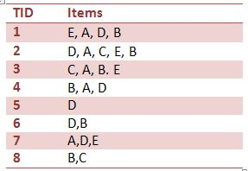
Example FP-Growth
Find all frequent itemsets or frequent patterns in the following database using FP-growth algorithm. Take minimum support as 30%.

Slide 41
Step 1 - Calculate Minimum support
First should calculate the minimum support count. Question says minimum support should be 30%. It calculate as follows: Minimum support count(30/100 * 8) = 2.4 As a result, 2.4 appears but to empower the easy calculation it can be rounded to the ceiling value. Now, Minimum support count is ceiling(30/100 * 8) = 3

Slide 42
Step 2 - Find frequency of occurrence
Now time to find the frequency of occurrence of each item in the Database table. For example, item A occurs in row 1,row 2,row 3,row 4 and row 7. Totally 5 times occurs in the Database table.
Item | Frequency
A | 5
B | 6
C | 3
D | 6
E | 4

Slide 43
Step 3 - Prioritize the items
Item B got the highest priority due to it's highest number of occurrences. At the same time you have opportunity to drop the items which not fulfill the minimum support requirement. For instance, if Database contain F which has frequency 1, then you can drop it. The frequent item list for the above table will be B:6, D:6, A: 5, E:4, C: 3.

Slide 44
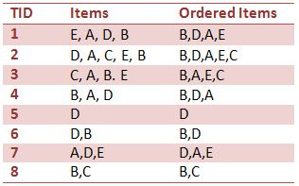
Step 4 -Order the items according to priority In the Ordered Items column all the items are queued according to it's priority. For example, in the case of ordering row 1, the highest priority item is B and after that D, A and E respectively.

Slide 45
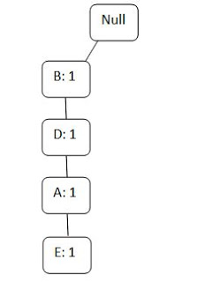
Create FP-Tree
Row 1: Note that all FP trees have 'null' node as the root node. So draw the root node first and attach the items of the row 1 one by one respectively. (See the Figure 1) And write their occurrences in front of it.

Slide 46
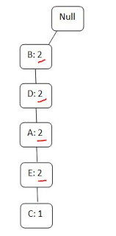
Row 2:
Then update the above tree (Figure 1) by entering the items of row 2. The items of row 2 are B,D,A,E,C. Then without creating another branch you can go through the previous branch up to E and then you have to create new node after that for C.
When you going through the branch second time you should erase one and write two for indicating the two times you visit to that node. If you visit through three times then write three after erase two.

Slide 47
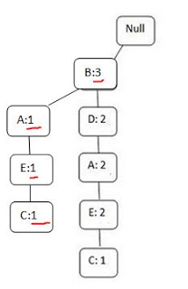
Row 3:
In row 3 you have to visit B,A,E and C respectively. So you may think you can follow the same branch again by replacing the values of B,A,E and C . But you can't do that you have opportunity to come through the B. But can't connect B to existing A overtaking D. As a result you should draw another A and connect it to B and then connect new E to that A and new C to new E.

Slide 48
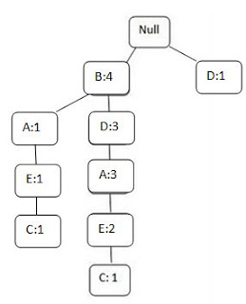
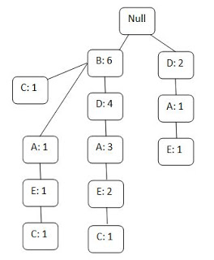

Slide 49
Items | Conditional pattern base
C | {B:1}, {E,A,B:1}, {E,A,D,B:1}
E | {A,B:1}, {A,D,B:2}, {A,D:1}
A | {B:1}, {D,B:3}, {D:1}
D | {B:4}
B
Items | Conditional pattern base | Conditional FP-tree
C | {B:1}, {E,A,B:1}, {E,A,D,B:1}, | {B:3}
E | {A,B:1}, {A,D,B:2}, {A,D:1} | {A,B:3}
A | {B:1}, {D,B:3}, {D:1} | {D:3,B:4}
D | {B:4} | {B:4}
B
Items | Conditional pattern base | Conditional FP-tree | Frequent Pattern
C | {B:1}, {E,A,B:1}, {E,A,D,B:1} | {B:3} | {C,B:3}
E | {A,B:1}, {A,D,B:2}, {A,D:1} | {A,B:3} | {E,A:3}, {E,B:3}, {E,A,B:3}
A | {B:1}, {D,B:3}, {D:1} | {D:3,B:4} | {A,D:3}, {A,B:4}, {A,D,B:3}
D | {B:4} | {B:4} | {D , B:4}
B

Slide 50
References
https://youtu.be/guVvtZ7ZClw
https://www.geeksforgeeks.org/ml-frequent-pattern-growth-algorithm/

